Slide 1
Self Awareness
Wellness Wednesday
Mr. Charles Coiro, USCG LDC10-4-23
Notes:
Dear Shipmates,
Self-knowledge is liberating. Stephen Covey refers to our four human endowments: self-awareness, conscience, independent will, and creative imagination – as what provides ultimate human freedom…the power to choose, to respond and to change. David Goggins reflects that the most important conversations we ever have are the ones we have with ourselves. Self-awareness has long been a foundational aspect of leadership and personal effectiveness. Join Mr. Charlie Coiro from the Coast Guard’s Leadership Development Center as he explores key areas of self-awareness and shares exercises and prompts that will help you on your journey to become more self-aware and continue growing. This session will provide you with tools to explore what makes you the person you are and consider how your actions impact the people in your life.
**Please note this is a new URL - Wellness Wednesday is being hosted on the below CG Teams site from 1500-1600 ET.
https://dod.teams.microsoft.us/l/meetup-join/19%3adod%3ameeting_8cc5cb90fd1a44ad8f7313f4f3095afb%40thread.v2/0?context=%7b%22Tid%22%3a%22369ba0d5-02cb-4d2f-94fd-9212cc24b78c%22%2c%22Oid%22%3a%22adc478d8-ca49-4c6c-b614-f5ce75cb132a%22%7d
If you cannot access the sessions, you may call-in via the phone bridge: +1 410-874-6742, Conference ID: 646-365-62# **
If you have questions or suggestions, you may e-mail us at wellnesswednesday@uscg.mil. Wellness Wednesday recordings are available on the CG-111 Health Promotion Website: Health Promotion Resources | Office of Work-Life Programs (CG-111) (uscg.mil)
** If you know someone in need of support, please connect them with Suicide & Crisis Lifeline by dialing or texting 988 from any phone. The line is available 7 days a week/24 hour a day**
Semper Paratus et Semper Salutaris!
RADM Dana Thomas
Chief Medical Officer
U.S. Coast Guard
“I am the master of my fate: I am the captain of my soul.” From the poem Invictus by William Ernest Henley

Slide 2
3 Questions people on your team want answered.
Who are you?
Where are we (you) headed?
What are you going to do?
Notes:
Princeton University Study 1973
Situational and Dispositional Variable in Helping Behavior
https://greatergood.berkeley.edu/images/uploads/Darley-JersualemJericho.pdf

Slide 3
Who are you?

Slide 4
"The unexamined life is not worth living."
Socrates
"The non-reflective leader is not worth having."
Charlie
Notes:
The world is complex, but we don’t need to make it complicated.

Slide 6
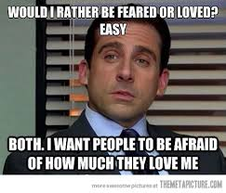

Slide 7
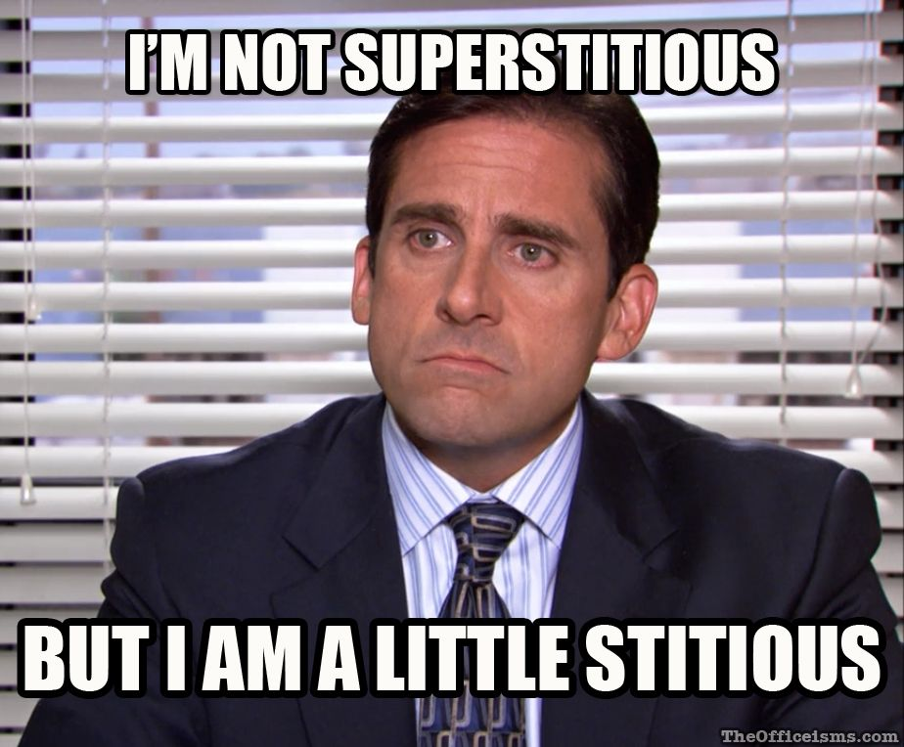

Slide 8
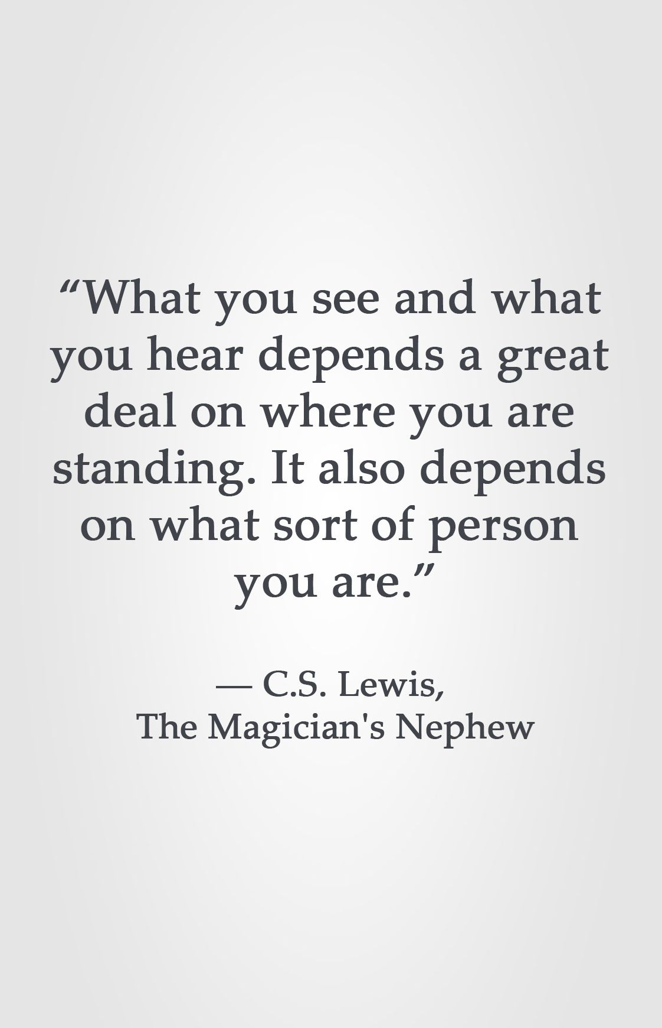

Slide 9
What makes you, you?

Slide 10
Aspects of Identity
Our family connections
How we process information
Family structure
Parental status
Marital/Partnership
Recreation
Traditions
Values
Generation
Culture
Thinking
Learning
Interpersonal/Personality
Communication
Introvert
Extrovert
Context
Content
Our work connections
How we see ourselves
Profession
Work experience
Work location
Expertise/Focus
Role/Function
Length of employment
Level of influence
Credential/Certification
Age
Gender
Gender Identity
Race
Our social connections
What we believe to be true
Economic
Political
Social
Language/lexicon
Origin
Education
Geographical
Social Class
Beliefs
Practices/Habits
Convictions
Attitudes
Passions
Religion
Spirituality
Culture

Slide 11
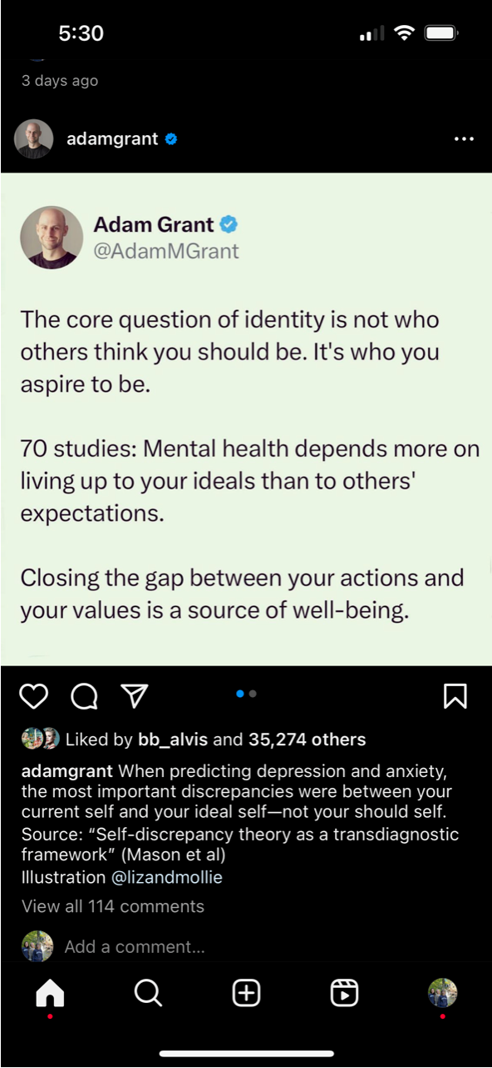
Adam Grant and Identity

Slide 12
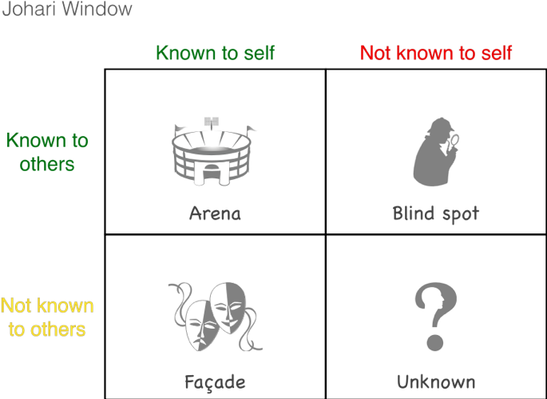
Johari Window
E.R.S.I.
FEEDBACK
“The Trust Paradox”
DISCLOSURE
Mindfulness & Reflection
Notes:
E.R.S.I = Extremely Realistic Self Image

Slide 13
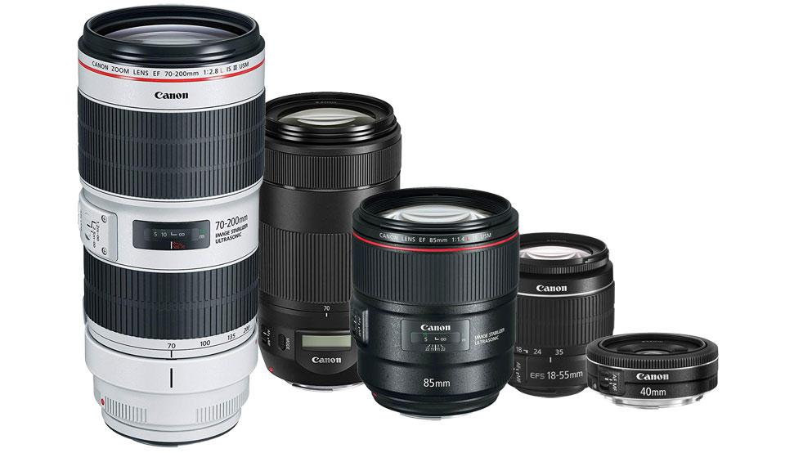
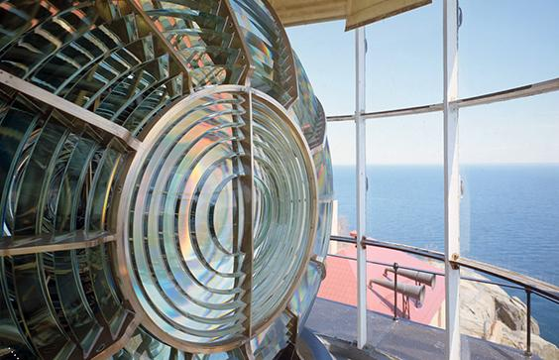
Personality
Values
Experiences

Slide 14
Personality

Slide 15
Personality
Personality Lenses to Consider:
MBTI (Myers Briggs Type Indicator) / Temperament
DiSC
Big Five
Enneagram
Firo-B
Styles (Conflict, Communication, Team, Habits, etc.)
Herman Brain Dominance
Others

Slide 16
There’s two types of people . . .
Those who say there’s two types of people
2) Those who don’t.

Slide 17
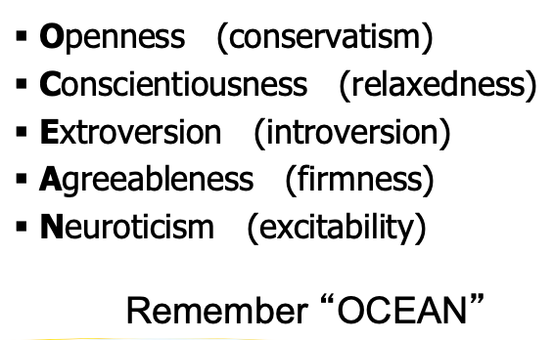
“The Big Five”

Slide 18
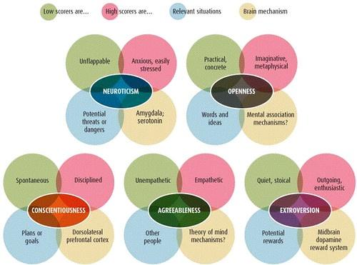
Notes:
https://images.app.goo.gl/75vjiCs2zxWitBJK6
https://www.cyberphysics.co.uk/MobileVersion/MBTI/Big_Five_Personality.htm

Slide 19
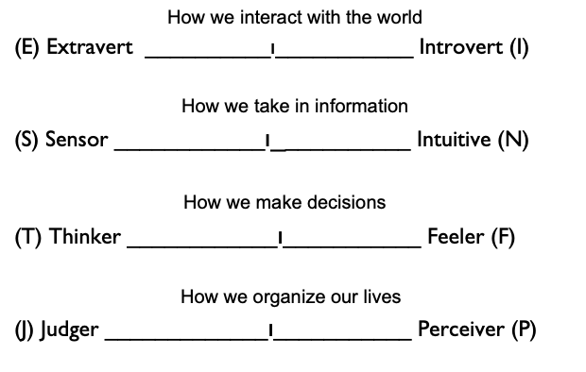
MBTI Model of Personality

Slide 20
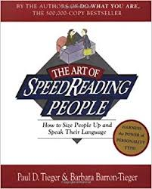
Books by Paul Tieger: - Art of SpeedReading People - Just Your Type - Nurture by Nature - Do What You Are

Slide 21
The 4 Temperaments are consistent with Type
Traditionalist = SJ
Sensor Judger
Experiencer = SP
Sensor Perceiver
Conceptualizer = NT
iNtuitive Thinker
Idealist = NF
iNtuitive Feeler
These 4 particular pairings of type preferences
most deeply reflect our values and motivations.

Slide 22
Each Type fits under one of the 4 Temperaments
Traditionalist
SJ
Experiencer
SP
Conceptualizer
NT
Idealist
NF
40%
30%
15%
15%
.
=
Responsibility
=
Action
=
Expertise
=
Relationships
ESTJ ISTJ
ESFJ ISFJ
ESTP ISTP
ESFP ISFP
ENTP INTP
ENTJ INTJ
ENFP INFP
ENFJ INFJ

Slide 23
The 4 Temperaments - Core Values
Traditionalist
SJ
Reliability, Responsibility, Duty, Service, Dependability
Experiencer
SP
Action, Practicality, Efficiency, Tangible Results
Conceptualizer
NT
Expertise, Competence, Long-Term Success
Idealist
NF
Meaningful Relationships, Authenticity, Long-Term Impact on Others
Notes:
______________________________________________________________________________________________________________________________________________________________________________________________________________________________________________________________________________________________________________________________________________________________________________________________________________________________________________________________________________________________________________________________________________________________________________________________________________________________________________________________________________________________________________________________________________________________________________________________________

Slide 24
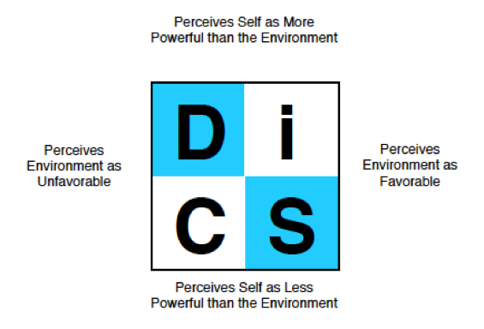
DiSC - Dominance / Influence /
Steadiness / Conscientiousness

Slide 25
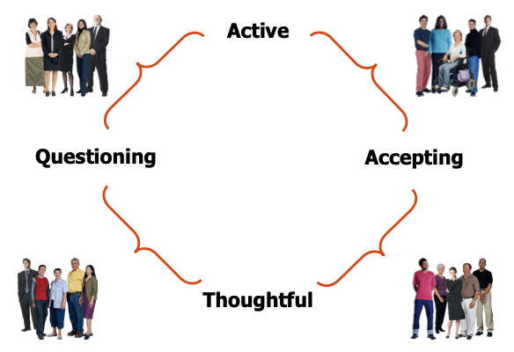
DiSC - Dominance / Influence /
Steadiness / Conscientiousness

Slide 26
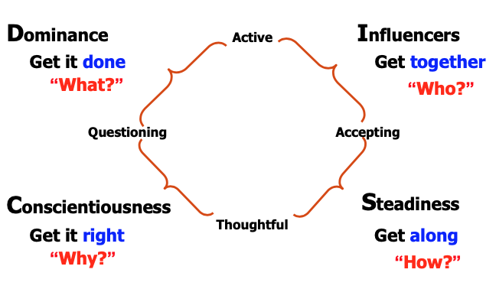
DiSC - Dominance / Influence /
Steadiness / Conscientiousness

Slide 27
VIA - Character Strengths
Values Cards
Prioritization
Values Integrity and Habits
Values

Slide 28
Website (on MS Teams): https://www.viacharacter.org/survey/account/register

Slide 29
Charlie’s Highest VIA Values:

Slide 30
Charlie’s Lowest VIA Values:

Slide 32
Student Guide Pg 19

Slide 33
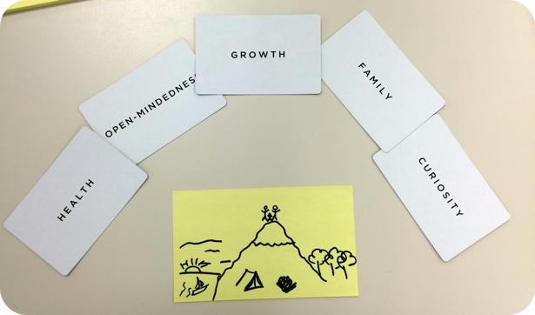

Slide 34
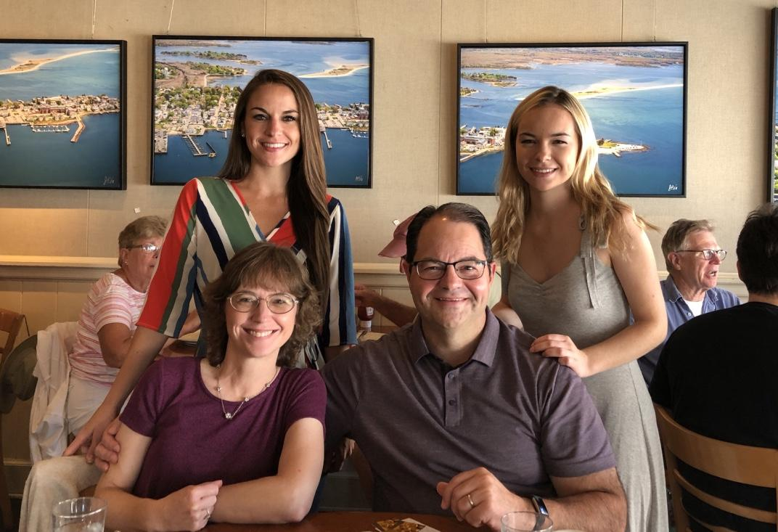
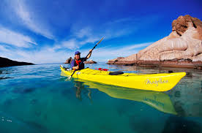

Slide 35
Values Integrity & Habits

Slide 36
Personality
Values
Experiences

Slide 37
Basic Prompts to help you Reflect on Experiences:
What ROLES do you have/had?
What S.E.E.s (Significant Emotional Events) or “Crucible Moments” have you experienced?
What SUCCESSES/FAILURES have you experienced?
Experiences

Slide 38
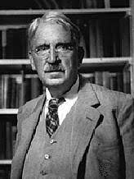

Slide 39
Tell us about a time when you were at your personal best as a leader.

Slide 40
“Life can only be understood backwards; but it must be lived forwards.”
— Søren Kierkegaard

Slide 41
Leadership Journey
Self Awareness & Decision Making

Slide 42
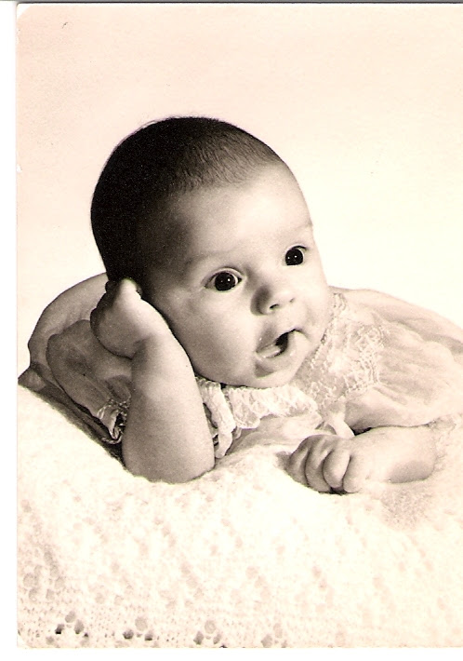
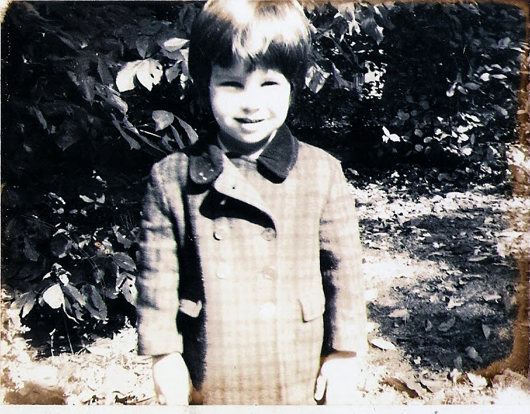
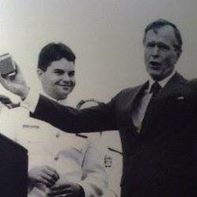
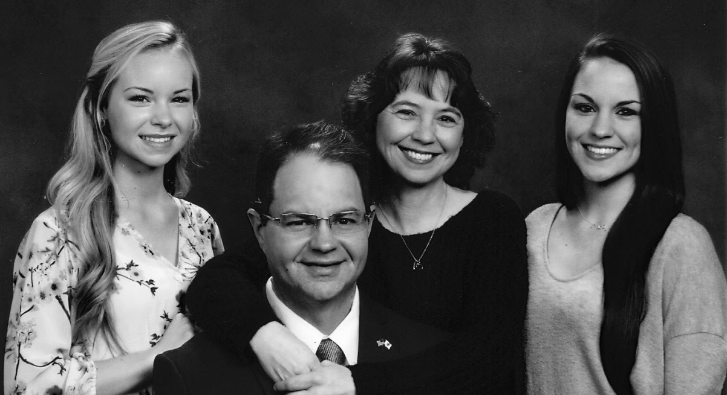
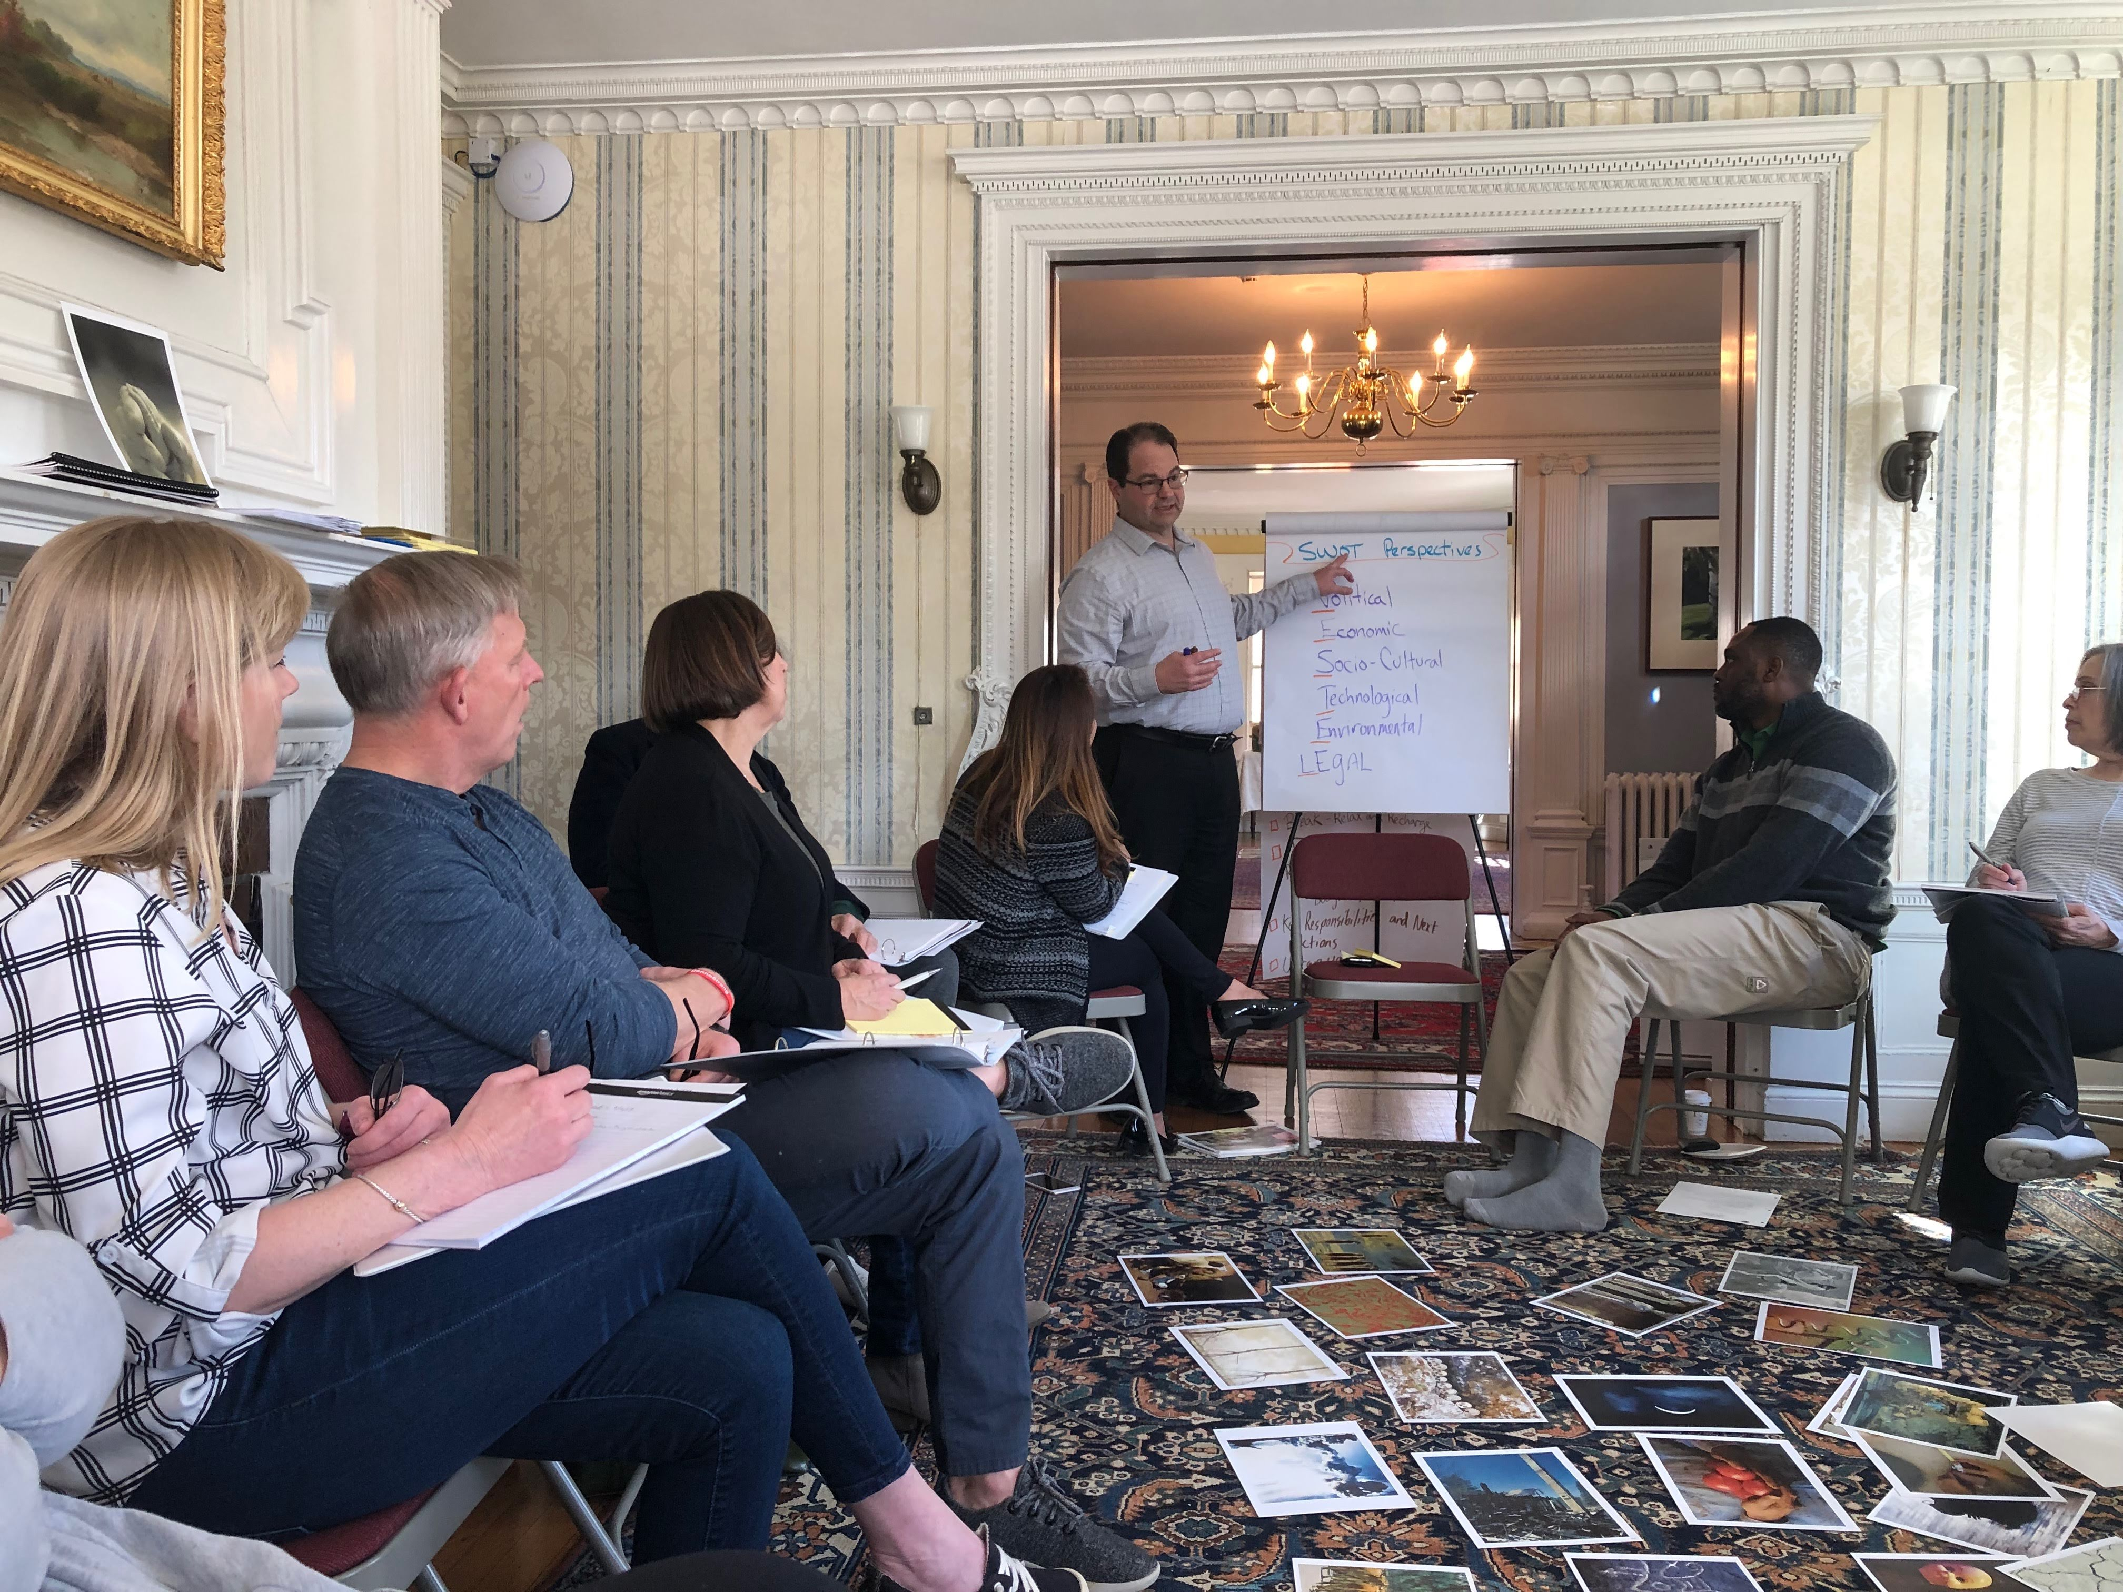
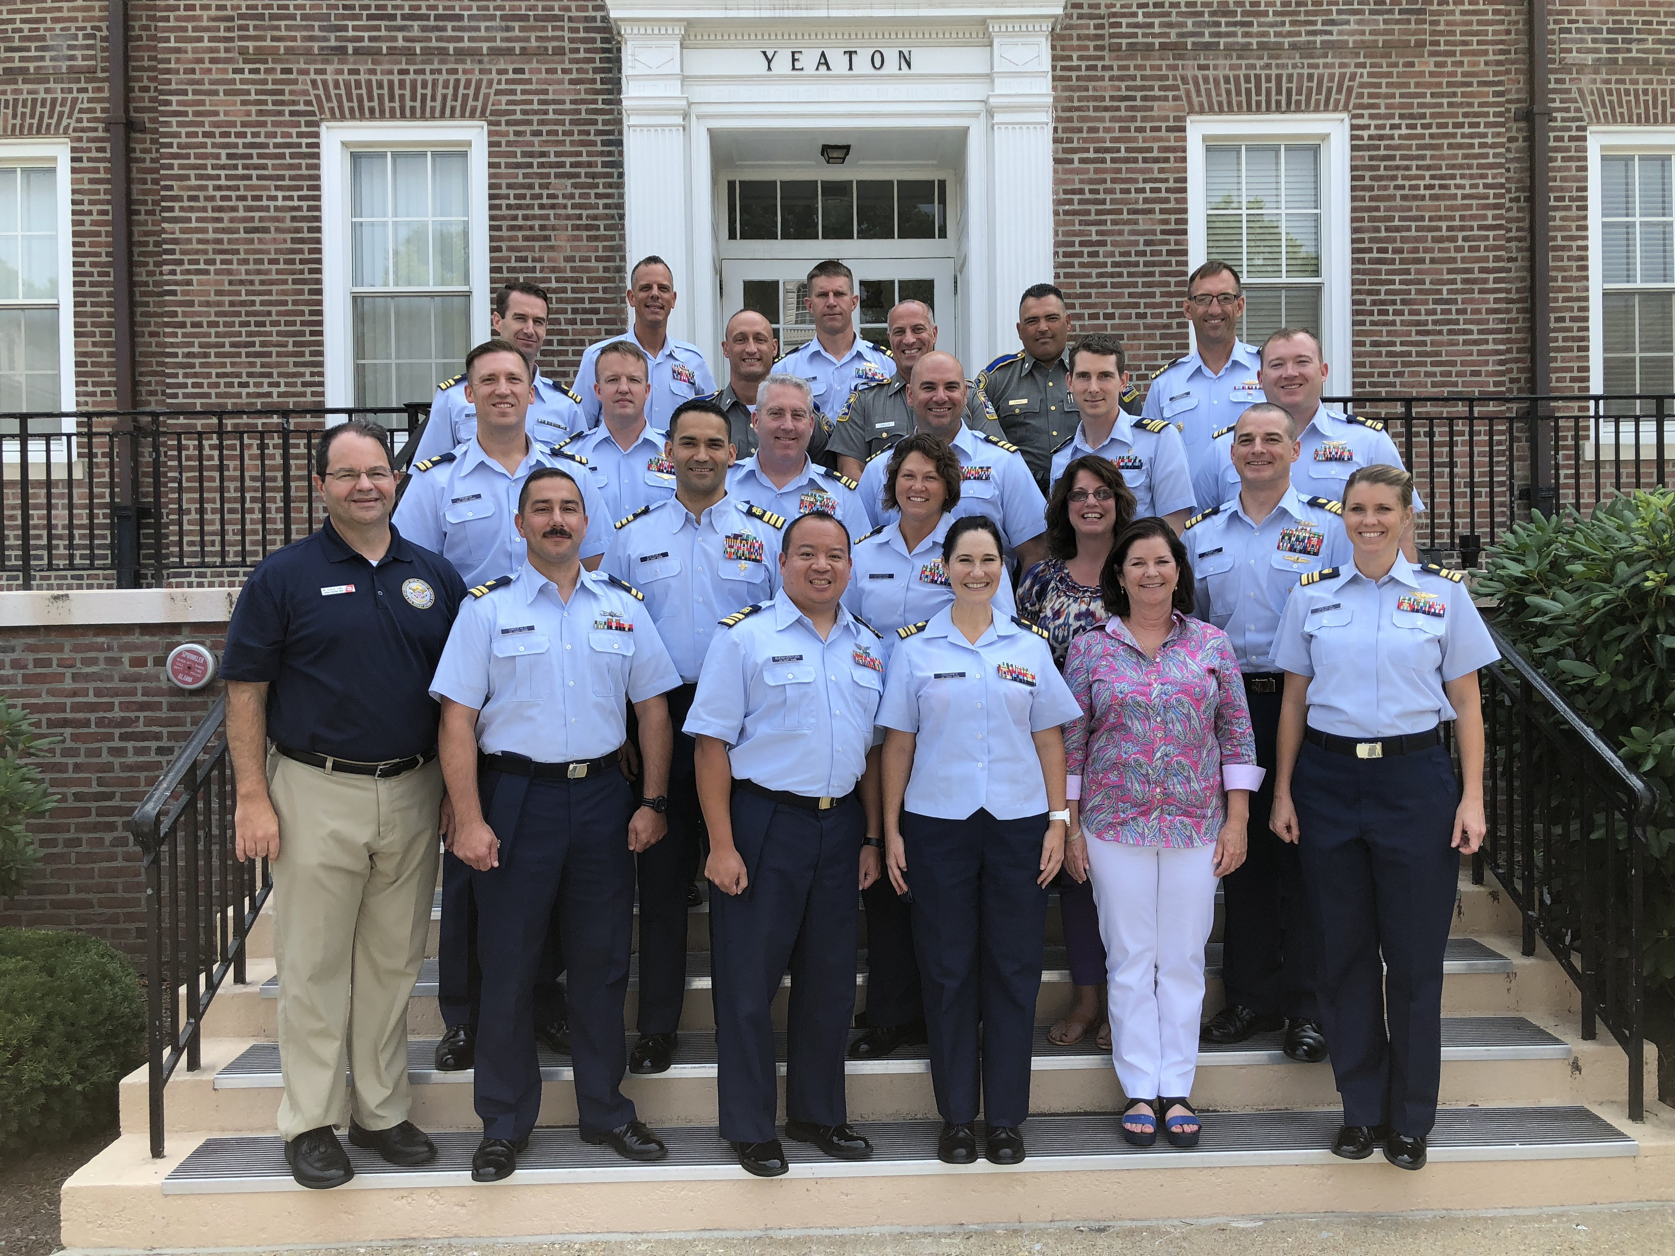

Slide 43
Decision-Making
Our decision-making process is around 50% based off how we remember our past, 40% how we view the future, and 10% the present.
The Leadership Journey is an exercise that helps us better understand our thought processes (mental models) impacting our decision making, especially those that hinder our ability to think differently and cause us to make repeated mistakes or limit our progress.
Next Jump Leadership Academy (2020)
Notes:
Often times we have a fuzzy recollection of what actually happened in the past. Instead, we remember a strong emotion associated with it (GOOD or BAD). By understanding the details of past situations to which we associate strong emotions, we are able to identify patterns that impact our decision making.
It is the start of an ongoing process to help us become better versions of who we are today.

Slide 44
Activity Objectives
Use the leadership journey to identify recurring patterns in your life and decision making.
To become more self aware and proactive in future key decision areas.
Apply reflective practice and diagnostic capabilities to view your life events and connect to future growth opportunities and actions

Slide 45
Quick Overview!

Slide 52
Leadership Journey: Ongoing (Iterate)
Iterate your story!
Reflecting on and learning from your journey is an ongoing process. As you learn more about your thinking patterns and limiting assumptions you can become a better critical thinker and leader of character.
For even more insight and learning, share your Leadership Journey with your team and ask them for feedback
Critical Thinking exercise
Character is consistency

Slide 53
Activity Objectives
Use the leadership journey to identify recurring patterns in your life and decision making.
To become more self aware and proactive in future key decision areas.
Apply reflective practice and diagnostic capabilities to view your life events and connect to future growth opportunities and actions

Slide 54
Who are you?

Slide 55
Charlie’s “Who Am I” Slide Values – Experiences – Personality

Slide 56
Q&A

Slide 57
References and Links:
Link to today’s slides: https://docs.google.com/presentation/d/10SLuO76tjCuxkKLwcz84jfBRAKWacIhi0dAxjNJCAGQ/edit?usp=sharing
Load your “Who Am I Slides” here: https://docs.google.com/presentation/d/15Qw55QNfOdLMQjPaLNni5JsnwX5yK3N9oDwm3724QqM/edit?usp=sharing
Big Five: https://www.cyberphysics.co.uk/MobileVersion/MBTI/Big_Five_Personality.htm
DiSC: https://www.everythingdisc.com
MBTI: https://www.mbtionline.com/
Paul Tieger author of “Do What You Think You Are” https://www.wnpr.org/post/whats-best-job-your-personality
Enneagram: https://www.truity.com/test/enneagram-personality-test
FIRO-B: https://www.themyersbriggs.com/en-US/Products-and-Services/FIRO
Gretchen Rubin’s free assessment on habit formation styles: https://quiz.gretchenrubin.com/

